Slide 1

Multilingual Undesired TEXT Detection
SRM INSTITUTE OF SCIENCE AND TECHNOLOGY
COLLEGE OF ENGINEERING AND TECHNOLOGY
DEPARTMENT OF NETWORKING AND COMMUNICATIONS
18CSP107L / 18CSP108L- MINOR PROJECT / INTERNSHIP
Shivam Pandey RegNo:RA1911003010383
Mayank Sinha Reg No:RA1911003010386
Guide name: Dr. L. JayaKumar

Slide 2
Table of contents
Introduction
Motivation of the Project
Innovation Idea of the Project
Purpose of the Project
Scope of the Project

Slide 3

Introduction
FREEDOM OF SPEECH ON THE INTERNET HAS LED TO A PERVASIVE PRESENCE OF UNDESIRED COMMENTS IN ONLINE DISCUSSIONS. AN UNDESIRED COMMENT IS DEFINED AS A RUDE, DISRESPECTFUL, COMMENT THAT IS LIKELY TO MAKE OTHER USERS LEAVE A DISCUSSION. THIS SOFTWARE WILL FACILITATE AND MAINTAIN THE OPENNESS OF THE ONLINE COMMUNITY.

Slide 4
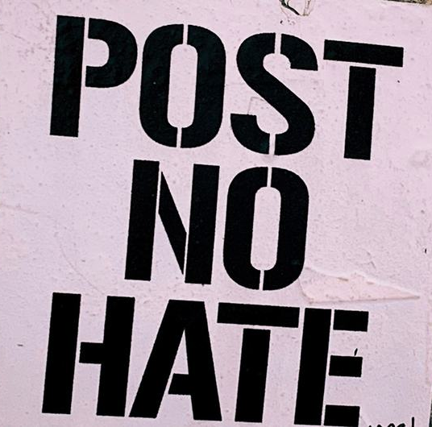
Motivation of the Project
The detection of hate text in social media is a crucial task. The uncontrolled spread of hate has the potential to gravely damage our society, and severely harm marginalized people or groups. A major arena for spreading hate speech online is social media. This significantly contributes to the difficulty of automatic detection, as social media posts include paralinguistic signals (e.g., emoticons, and hashtags), and their linguistic content contains plenty of poorly written text.

Slide 5

Innovation Idea of the Project
This is a Natural Language Processing project which detects hate speech on Online forums. This project uses Support Vector Machine(SVM) for the classification of the hate speech. Since this is a typical Machine Learning problem so Python will be our language of development. Our Front-end GUI is developed using streamlit which is the topmost choice of all machine Learning problem. This model can be used by any online forums and discussions websites so that a clean and disciplined environment can be maintained.

Slide 6
Purpose of the Project
This projects will be a blessing for the people who get feedbacks from customers via forms and don’t want hate comments and spam comments like hate speech.
Other than that people can use it on social media site to control undesired speech before commenting anywhere so as to not spread hate among others.

Slide 7

Scope of the Project
This project has a wide scope in the real world, because this algorithm can be used in the backend of several social media platform like Facebook, twitter, Instagram etc.
Several open forums like reddit, Pinterest etc can also use this project for keeping their community clean, so that anyone can safely share on these forums.

Slide 8
Thank you

